Slide 1
Azure Networking
David Benedic
Cardinal Solutions Group

Slide 2
Agenda
Virtual Networks
Network Security
Load Balancing

Slide 3
Virtual Networks

Slide 4
Azure Virtual Networks
A protected private virtual network in cloud
Extend enterprise networks into Azure
Cross-premises connectivity

Slide 5
Virtual Network Scenarios
Hybrid Public/Private Cloud
Enterprise app in Microsoft Azure requiring connectivity to on-premise resources
Enterprise Identity and Access Control
Manage identity and access control with on-premises resources (on-premises Active Directory)
Monitoring and Management
Remote monitoring and trouble-shooting of resources running in Azure
Advanced Connectivity Requirements
Cloud deployments requiring IP addresses and direct connectivity across services
Microsoft Azure

Slide 6






Cross-premises Connectivity
Site-to-site
Create a secure connection between your on-premises site and your virtual network
Point-to-site
Create a secure connection via VPN to your virtual network
ExpressRouteTM
Create a private connection between Azure data centers and infrastructures on your premises or in a co-location environment.
Connect at an ExpressRoute location (Exchange Provider facility)
Direct connect via a Network Service Provider
Microsoft Azure

Slide 7
Vnet-to-Vnet Peering
Easily connect virtual networks in the same region
Peer multiple virtual networks, even across subscriptions
No bandwidth throttling (connects through Azure backbone)
Microsoft Azure

Slide 8
Network Security

Slide 9
Load Balancing

Slide 10
Load balancing
Load balancing
Multiple VMs share the workload via public facing endpoints
Internal Load balancing
Load balancing between VMs that don’t have public facing endpoints
Microsoft Azure
Internet
Public VIP
Customer vNet
External Load Balancer
Internal Load Balancer
Microsoft Azure
Back end
Front end

Slide 11
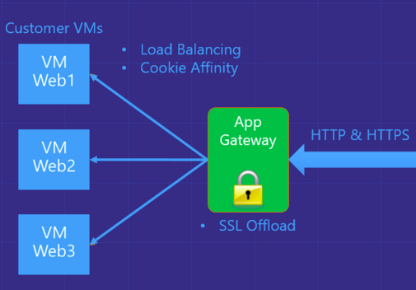
Azure Application Gateway
Azure-managed, layer 7 load balacner
HTTP routing based on app-level policies
Cookies affinity
URL hash
SSL termination and caching
Microsoft Azure

Slide 12
Traffic Manager
Load balancing
Priority Routing
Performance Routing
US West
North Europe
Microsoft Azure
North America
Europe

